Slide 1


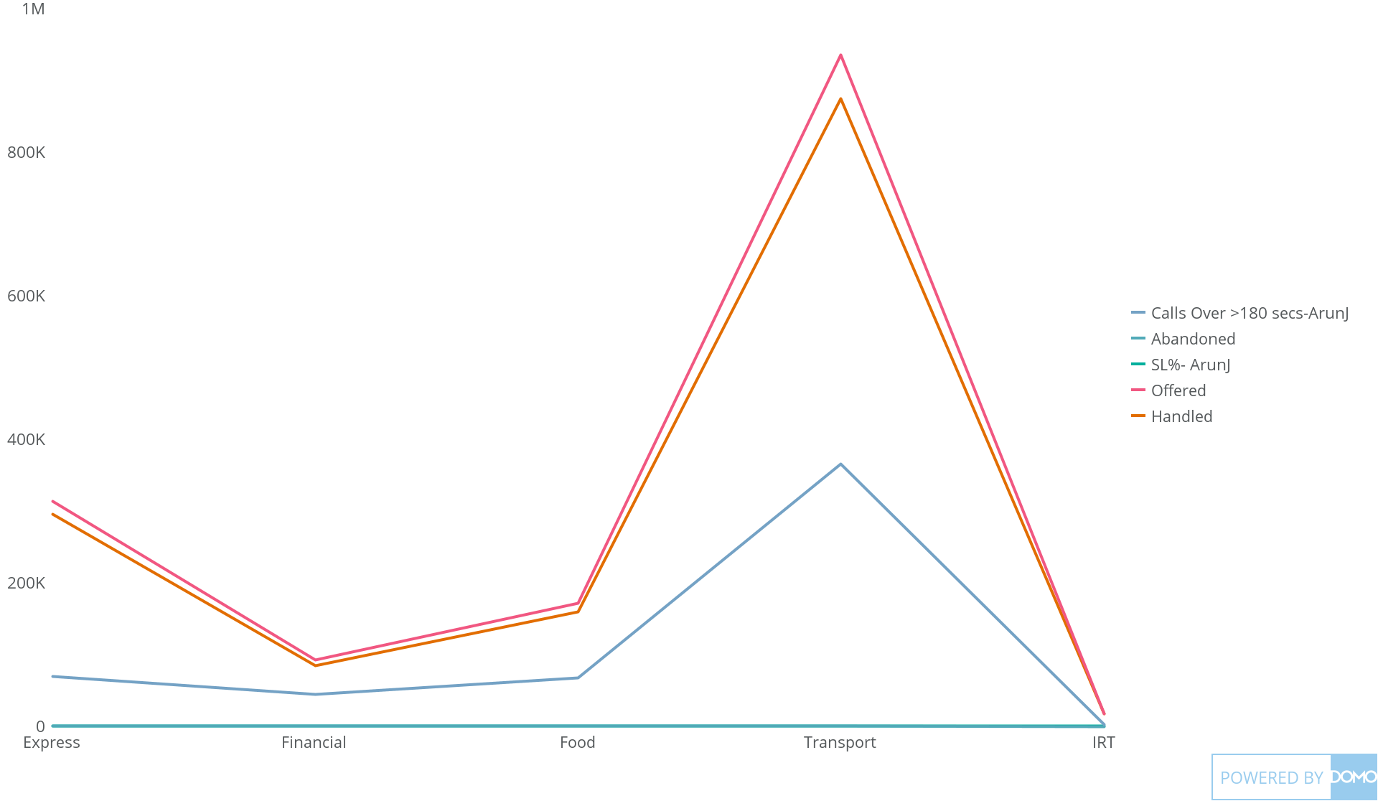
+
exported May 17, 2025, 12:34:00 PM UTC
PE 1 | CARD 7| LOB wise -MTD Performance(Offered VS Handled Vs SL)
This Year

